Slide 1
Azure Sentinel Hunting
Hands-On Challenge

Slide 2
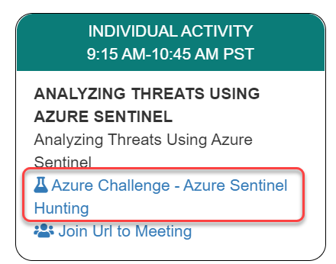
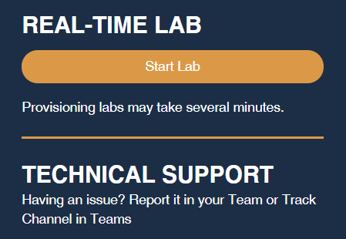
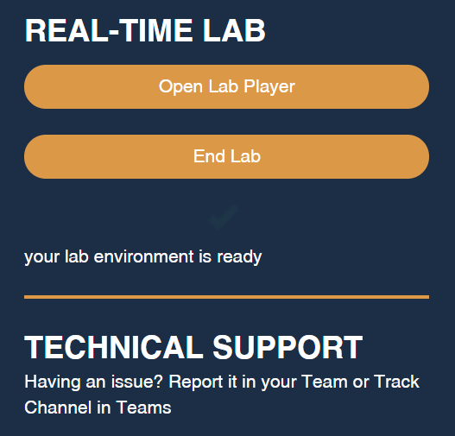
Launch the Lab Environment
Important! Allow at least 1 hour for your lab to start

Slide 3
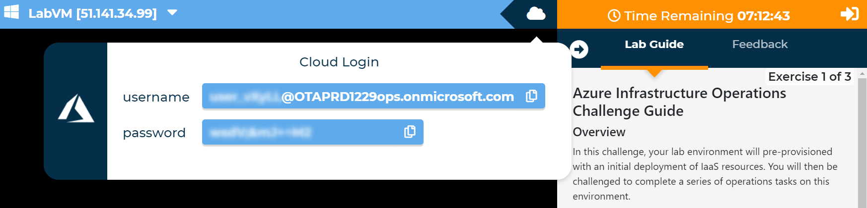
Access Your Lab
Important! Allow at least 1 hour for your lab to start

Slide 4
Challenges
Challenge 1: Understanding The Environment
Before you can extend and further configure Contoso Finance's Sentinel deployment, you need to understand what they have done to date and help them plan.
Challenge 2: Sentinel Alerting And Analytics
Now that you understand the data sources and volume of data that Contoso Finance is contending with, you can begin operationalizing the Sentinel deployment.
Challenge 3: Investigating Incidents
As alerts are generated and aggregated in incidents, you can begin hunting and making recommendations to Contoso Finance on how to improve their posture.
Note Automatic validation of your solution has been disabled to speed up the lab for you
Notes:
Contoso Finance has recently onboared to Microsoft Azure and as a part of the security conscious culture, they have adopted Azure Sentinel to gain insights into their on-premises and cloud security. They have a provisioned a Sentinel workspace and begun to incorporate event data from their on-premises devices, including their Fortinet Fortigate next general firewalls. You have been brought on to make sure that the alerting infrastructure and underlying deployment are properly configured and will provide ongoing incident management for generated alerts.

Slide 5
Need help?
Use the Teams chat channel

